Slide 1
Employee Salary prediction using Machine Learning
Presented By:
Jalla Jagannadharao – Raghu Engineering College – CSM

Slide 2
OUTLINE
Problem Statement
Data Collection & Preprocessing
Model Building & Evaluation
System Architecture & Deployment
Results & Screenshots
Conclusion
Future Scope
References

Slide 3
Problem Statement
The goal of this project is to build a machine learning model that predicts whether an employee earns more than $50K or not, based on features like age, education, occupation, hours per week, and experience. The solution helps HR teams automate and streamline high-income employee identification.

Slide 4
System Approach
System Requirements : Python, Streamlit, Jupyter Notebook , VS code.
Libraries Used: pandas, streamlit, joblib, scikit-learn, numpy, matplotlib, seaborn.

Slide 5
Algorithm & Deployment
Import Required Libraries
Load and Inspect Data
Data Cleaning And Preparation
Feature Encoding
Target Variable Encoding
Train-Test-Split
Feature Scaling
Model Building
Model Evaluation
Prediction

Slide 6
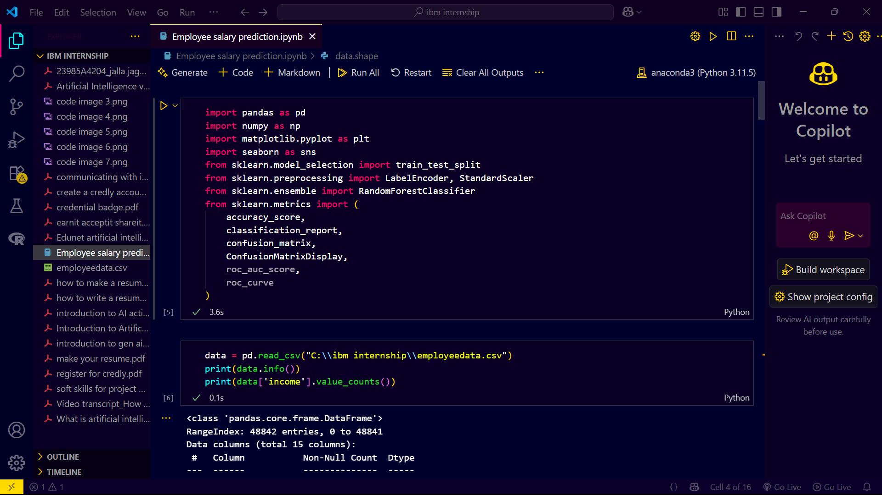
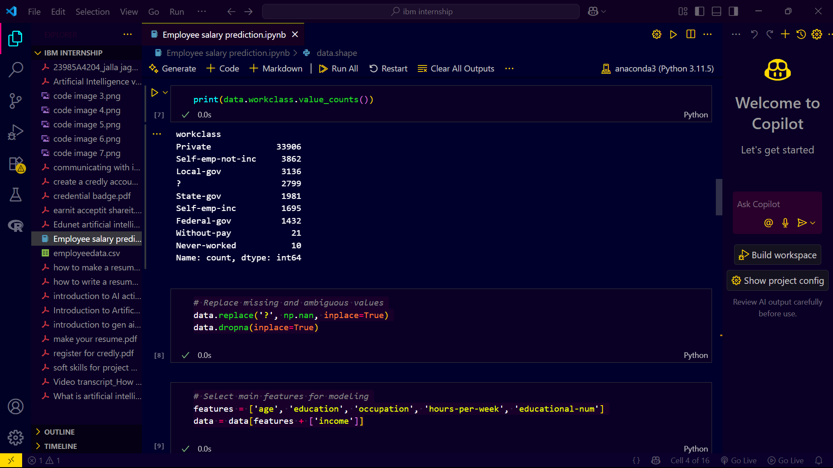
Input data

Slide 7
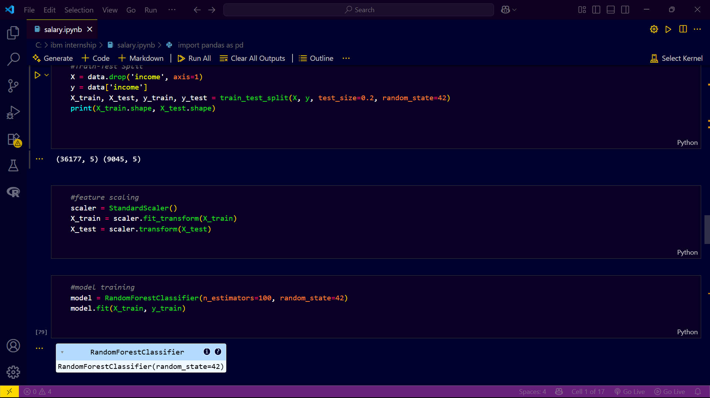
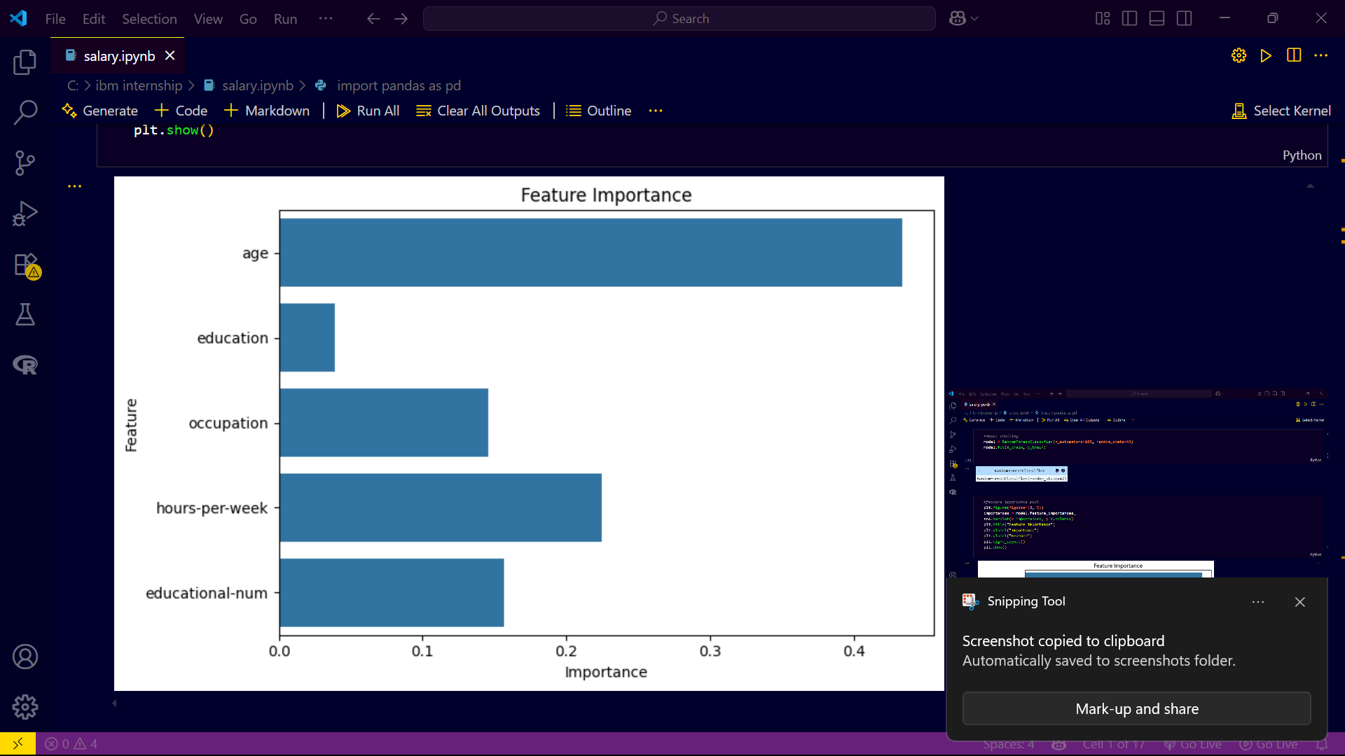
TRAIN-TEST-split and feature scaling

Slide 8
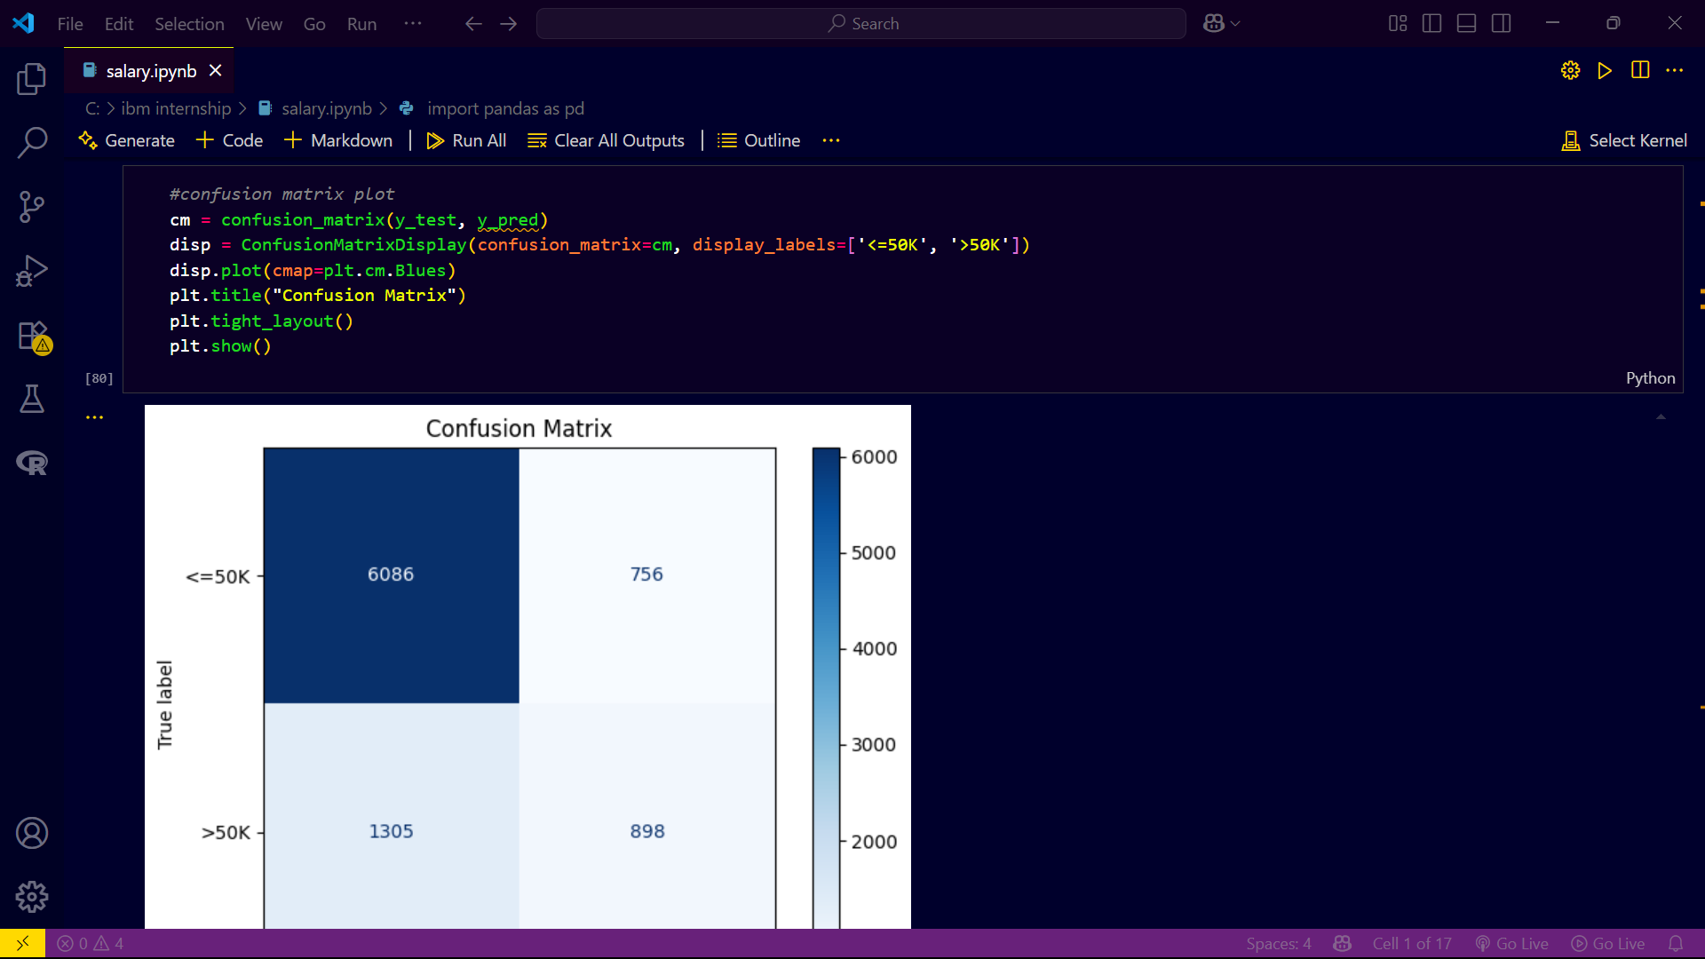
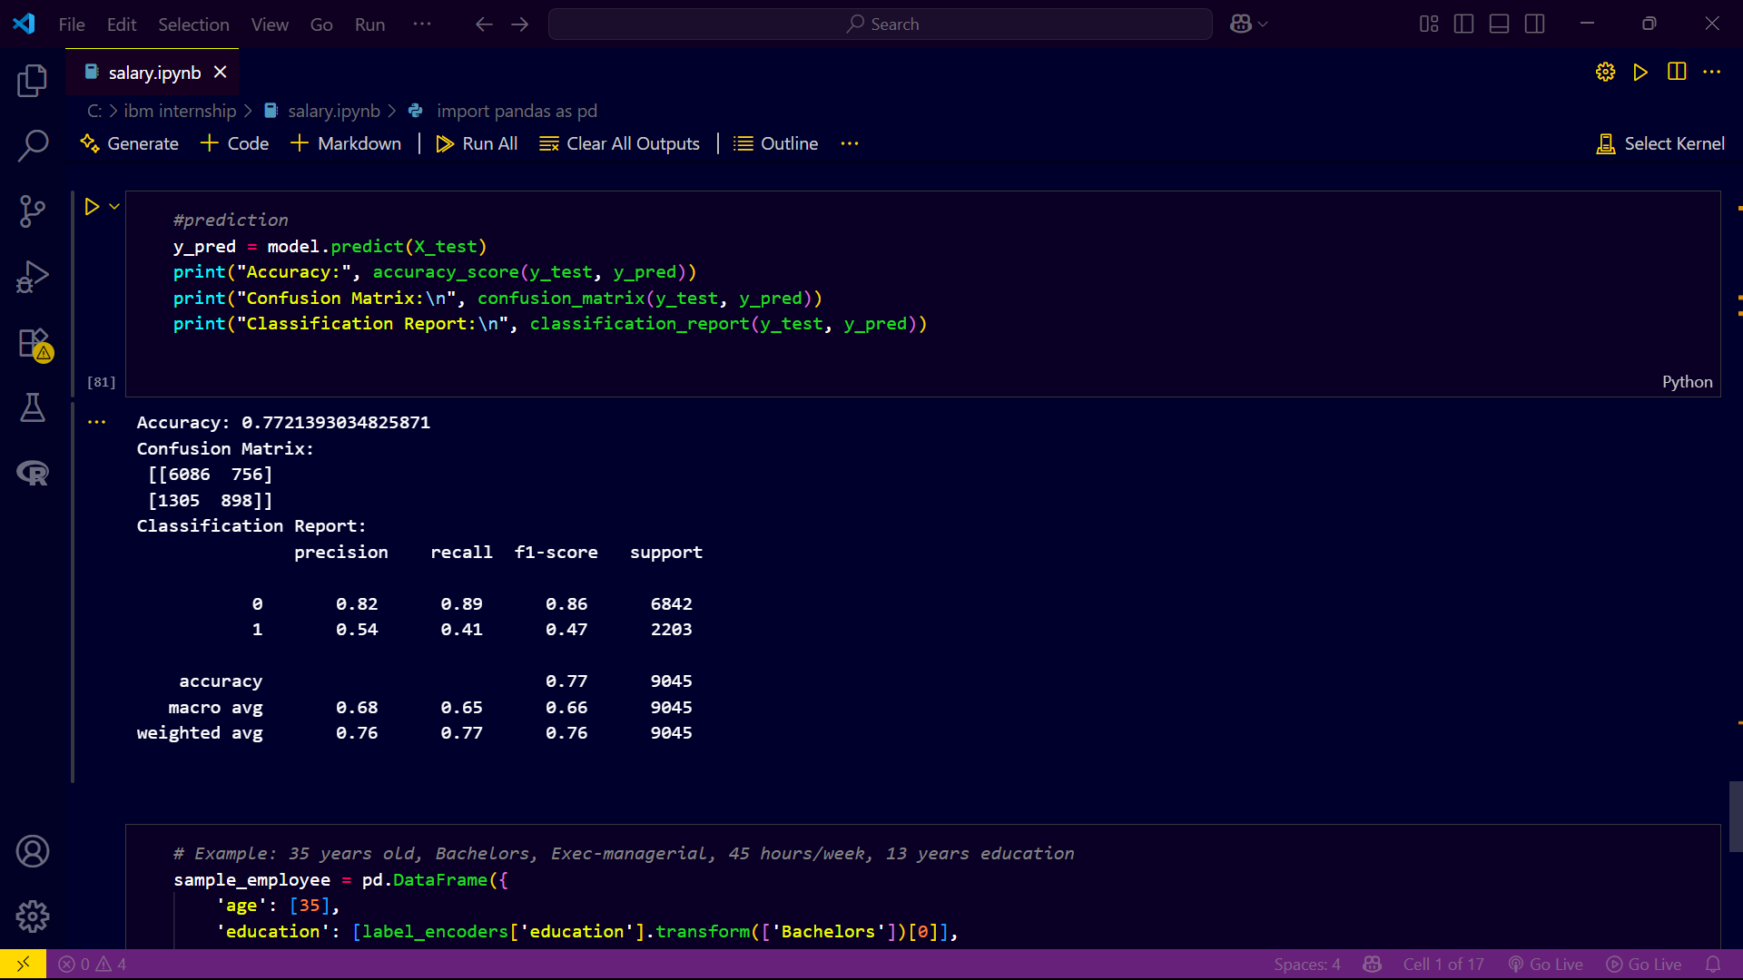
output : Confusion matrix and accuracy score

Slide 9
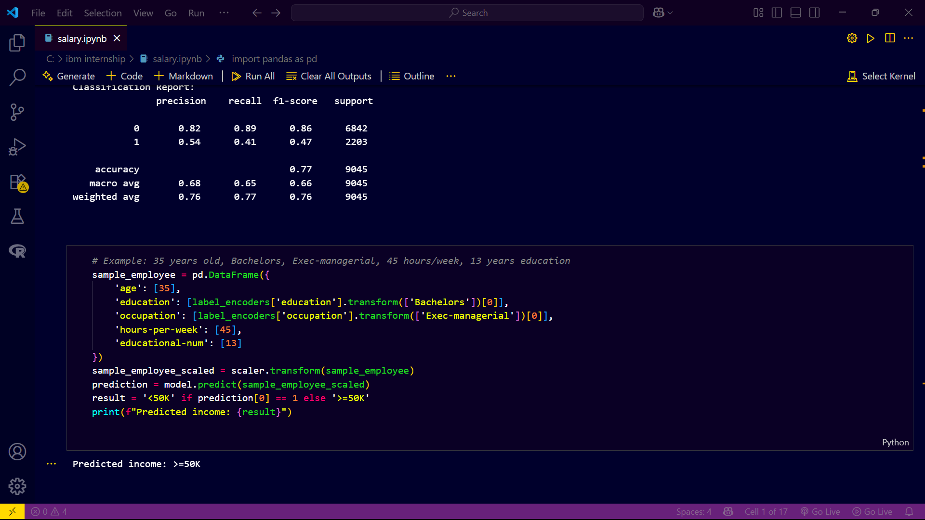
Example prediction

Slide 10
GitHub link :
https://github.com/jagannadharao8/Employee-Salary-Prediction

Slide 11
Conclusion
This project successfully implemented a machine learning solution for employee salary prediction with an accuracy of around 86%. The Random Forest model effectively distinguished high-income employees based on core demographic and work-related features. Key model metrics and feature visualizations confirm predictive power and transparency. This tool streamlines the HR decision process, supports bias mitigation, and enables data-driven planning. Challenges included data imbalance for high-income class and categorical data handling, addressed through encoding and model tuning.

Slide 12
Future scope
Integrate the model with HR management systems for real-time predictions.
Expand dataset features to include employer, location, or skill sets for deeper insights.
Further develop explainability (e.g., SHAP/LIME) for model transparency.
Ongoing bias audits to ensure fair predictions.

Slide 13
References
UCI Adult Dataset
Scikit-learn Documentation
Streamlit Documentation
Articles and Tutorials used during development

Slide 14
THANK YOU

